Slide 1
Content is not a strategy
March 21, 2013

Slide 2

About Me
Current: VP of Global Online Marketing at PGi
Previous: AutoTrader.com, Euro RSCG, Saatchi & Saatchi
Email: jeff.perkins@pgi.com
Twitter: @jeffperkins8
Blog: SingleMindedProposition.com
Father of two: Mia (5) and Ella (2)

Slide 3

About PGI
Global leader in virtual meetings
40,000 customers worldwide
Work with 75% of the Fortune 100
Every month we connect 17 million people together in nearly 4 million meetings
1,700 employees
Headquarters in Atlanta, GA

Slide 4


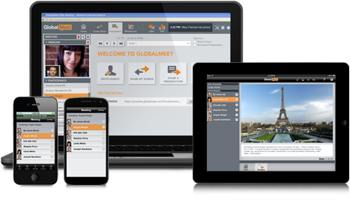
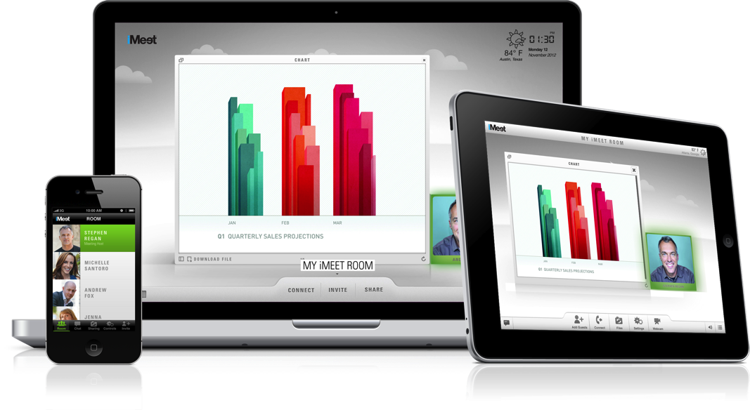
About PGi
An innovative new way to do web conferencing.
A better option for traditional web conferencing.

Slide 5
Content should be a solution to a problem.

Slide 6

My first content
The Problem: Tide was viewed as a traditional brand for traditional moms.

Slide 7
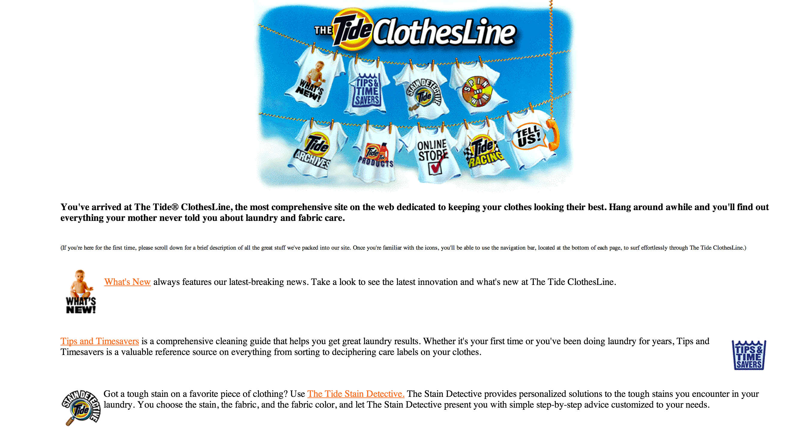
Tide.com

Slide 8
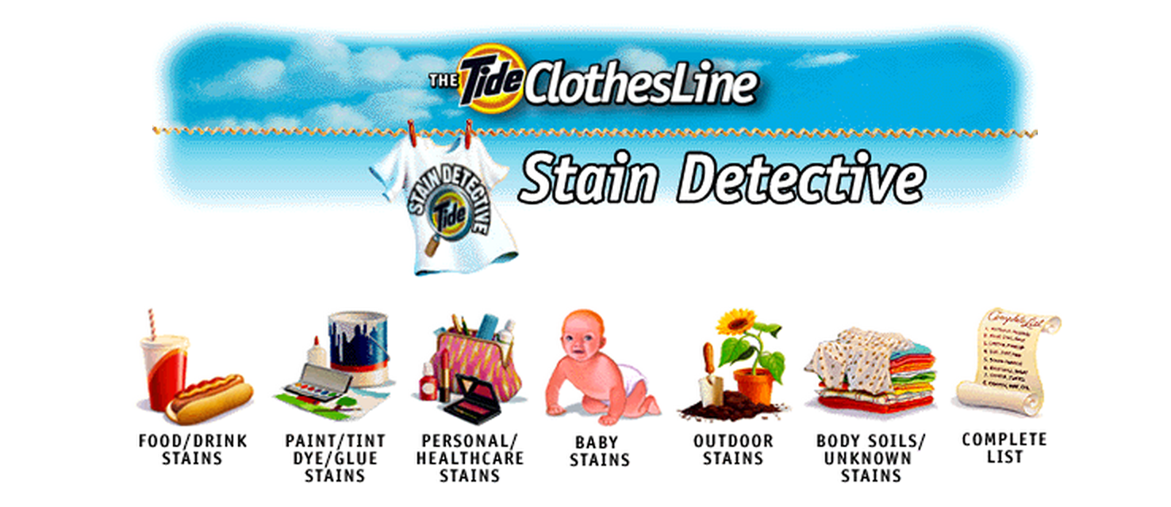
The Stain detective

Slide 9
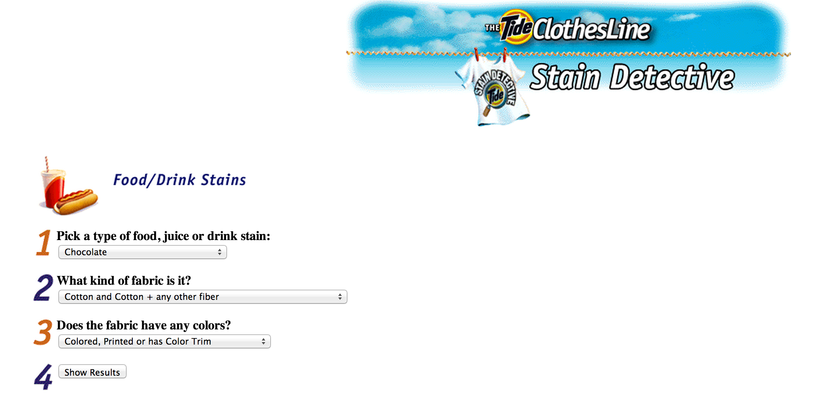
Any garment. Any stain.
Notes:
A way to engage, without making an overt sell.

Slide 10
results
Positioned Tide as a “progressive brand”
Brought new users into the brand
Disruptive content
Press and awards
Increase in market share

Slide 11

Autotrader.com
The Problem: Low customer satisfaction and high churn.
Notes:
The more satisfied customers were the ones we were doing more training with. But, it’s hard to do training for 20,000 customers across the country.

Slide 12
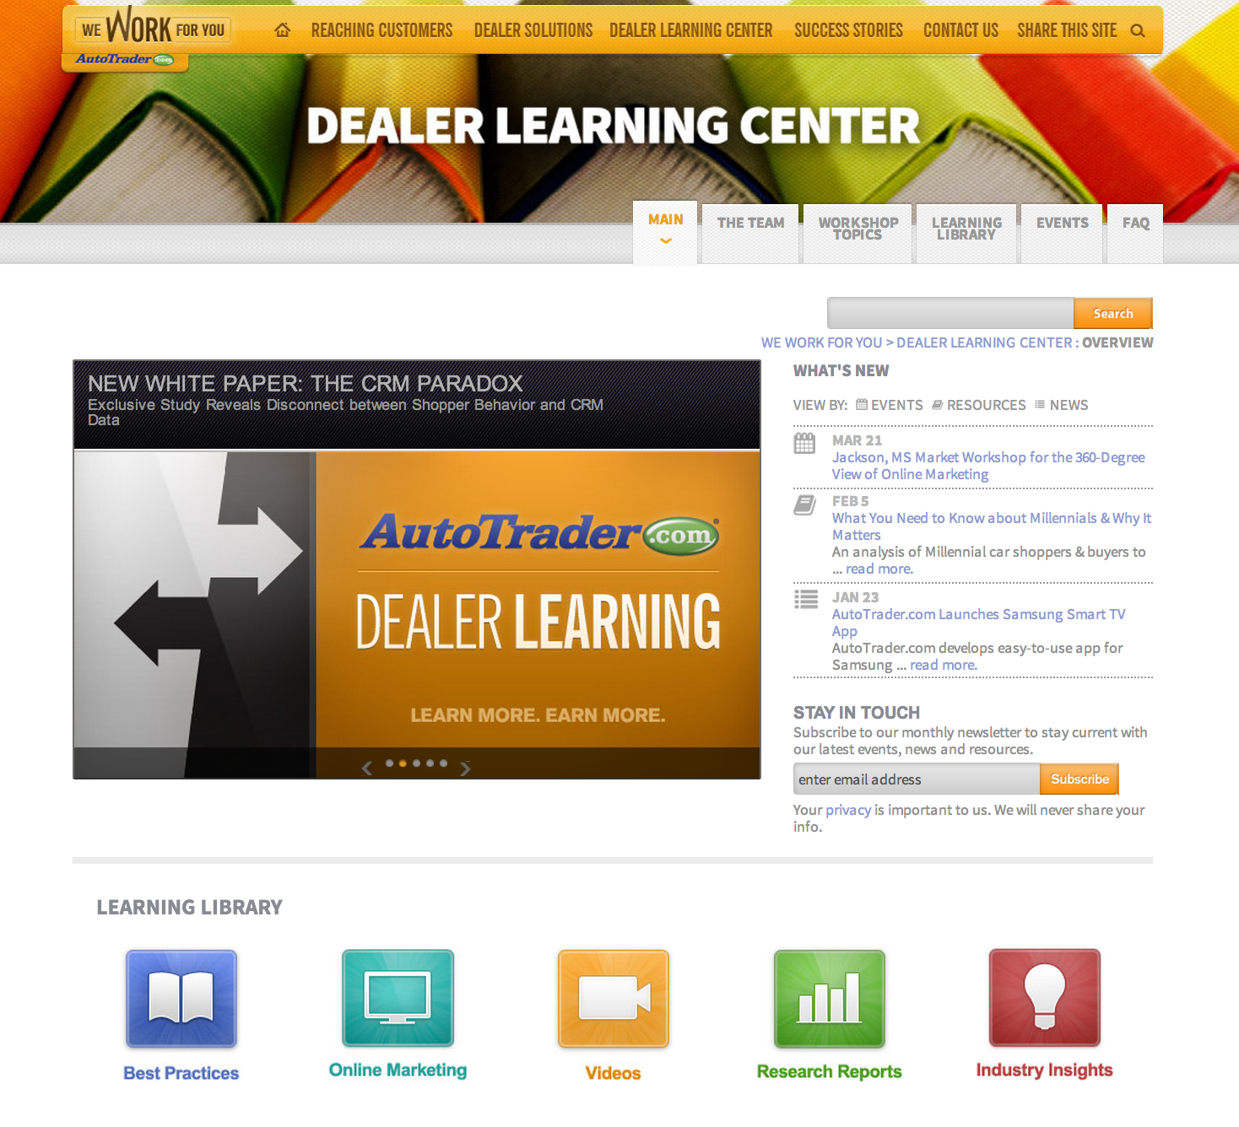
Autotrader.com dealer learning center

Slide 13
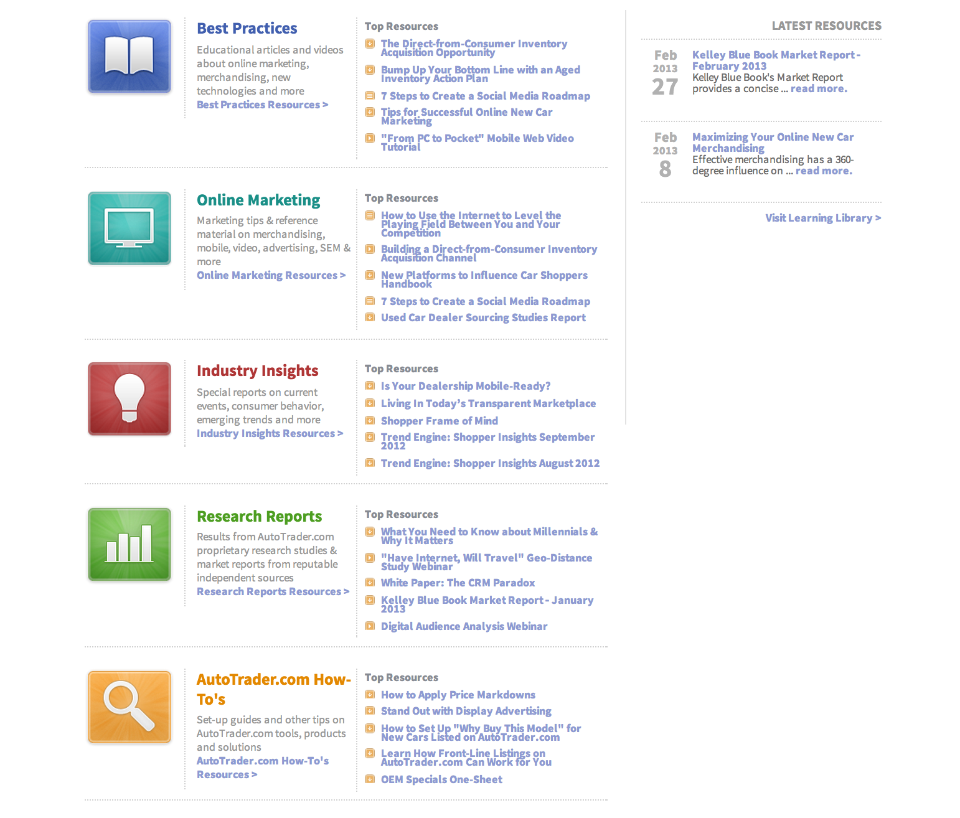
Topic variety
Notes:
More satisfied customers were better trained.

Slide 14
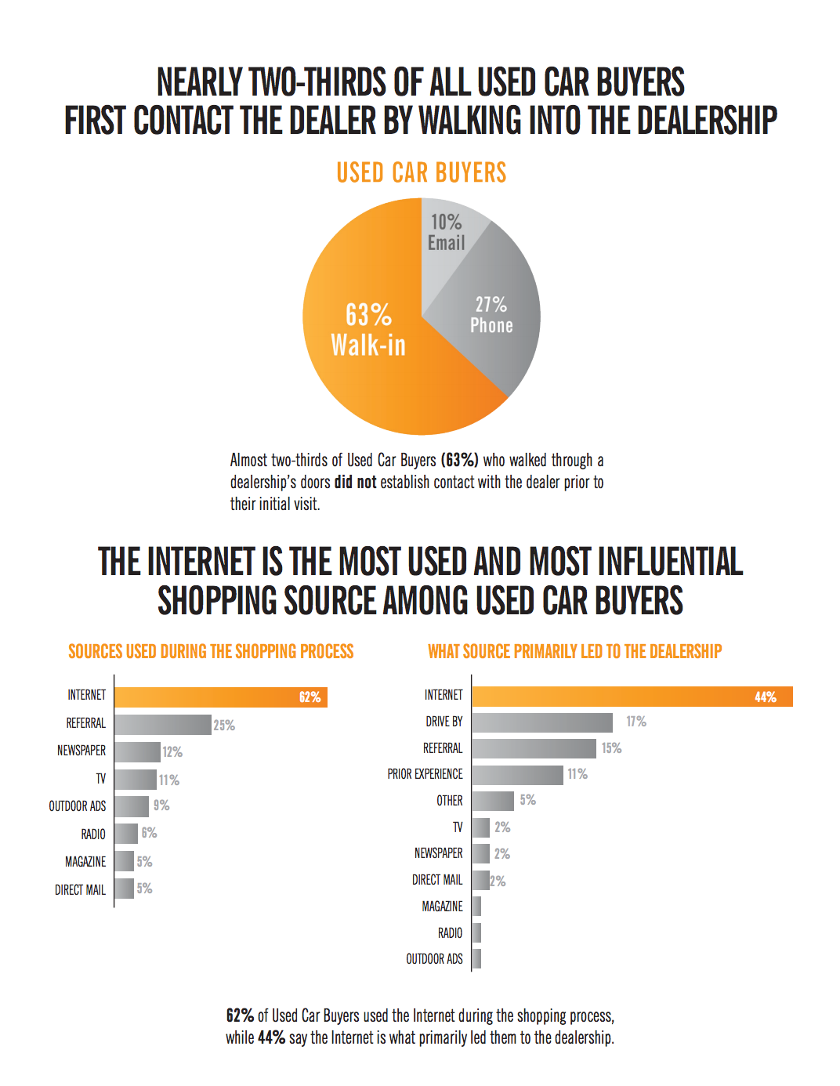
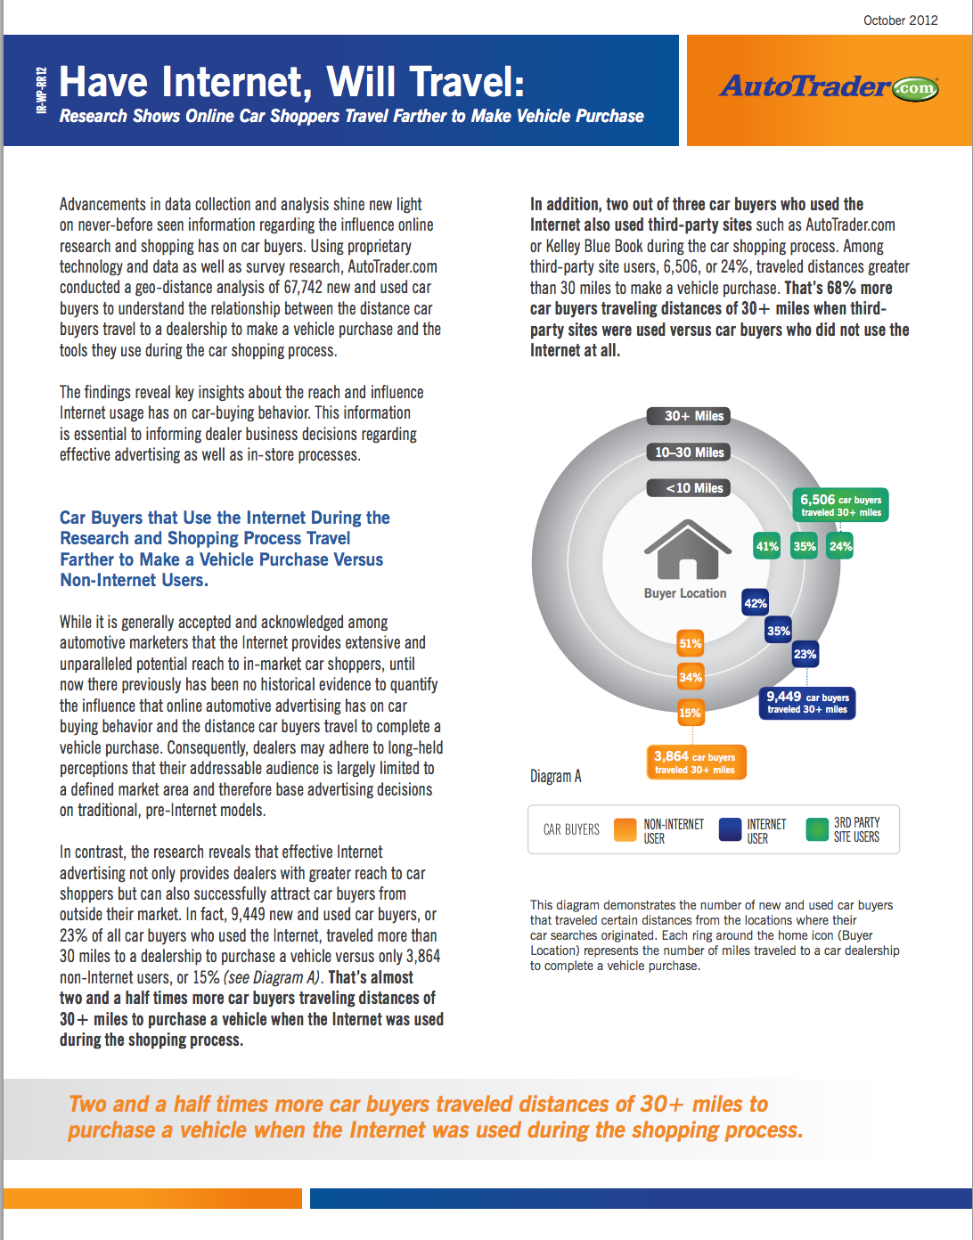
Research centric content

Slide 15
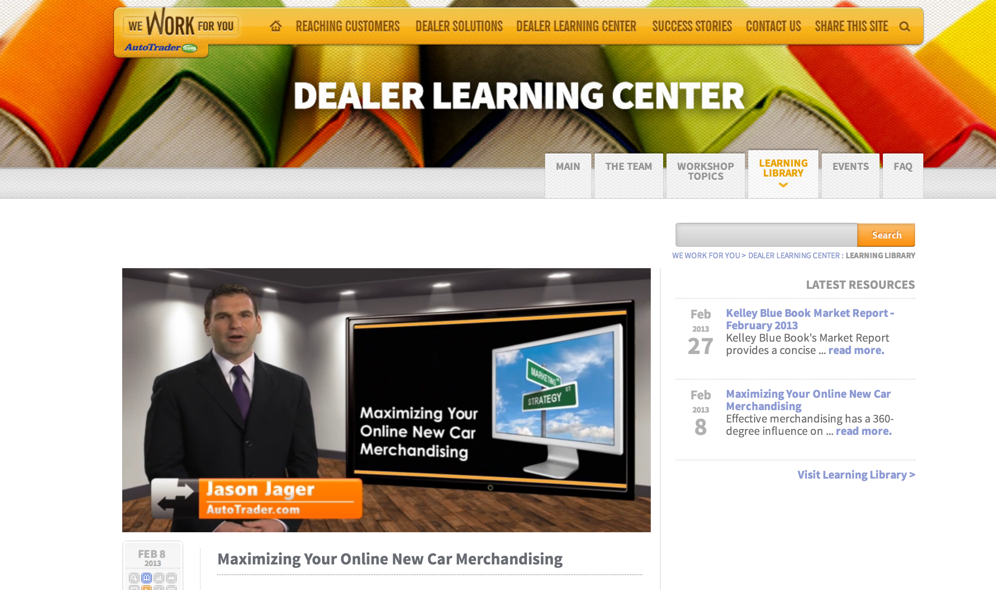
Video content

Slide 16
Results
Dramatic improvement in customer satisfaction
Customer churn went from 5% to below 1%
Perception of AutoTrader moved from a “vendor” to a “partner”
Increased sales

Slide 17
PGI
The Problem:
Need to drive qualified leads in a highly competitive category

Slide 18
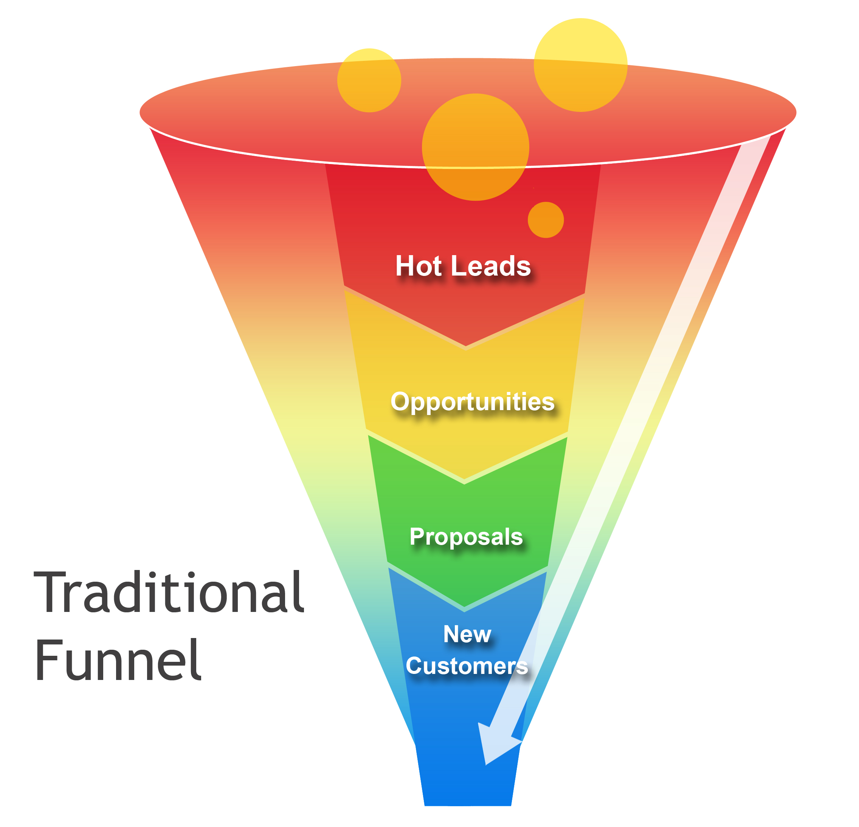
The sales funnel

Slide 19
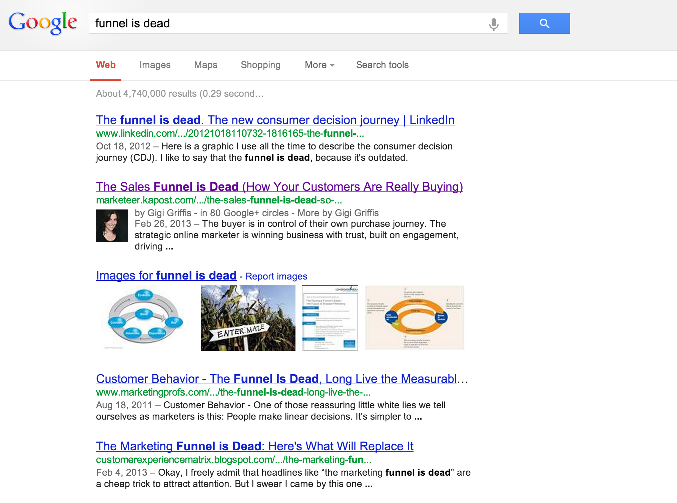
Rethinking the funnel

Slide 20

The sales “Cocktail shaker”?
Buyers are
70%
of the way through the purchase process before they engage a sales rep.

Slide 21
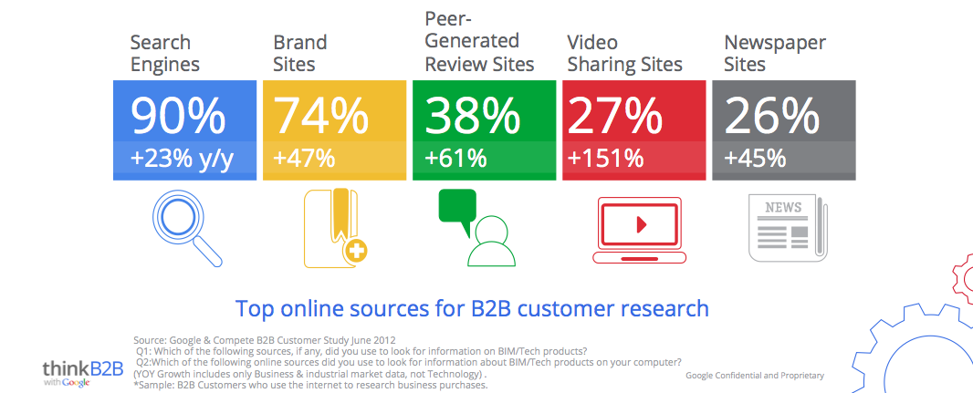
What are they doing?
Notes:
Today, our customers are going online to learn about everything. As you can see in this slide, they are using search engines, product websites, review sites to do their homework before they ever talk to you.

Slide 22
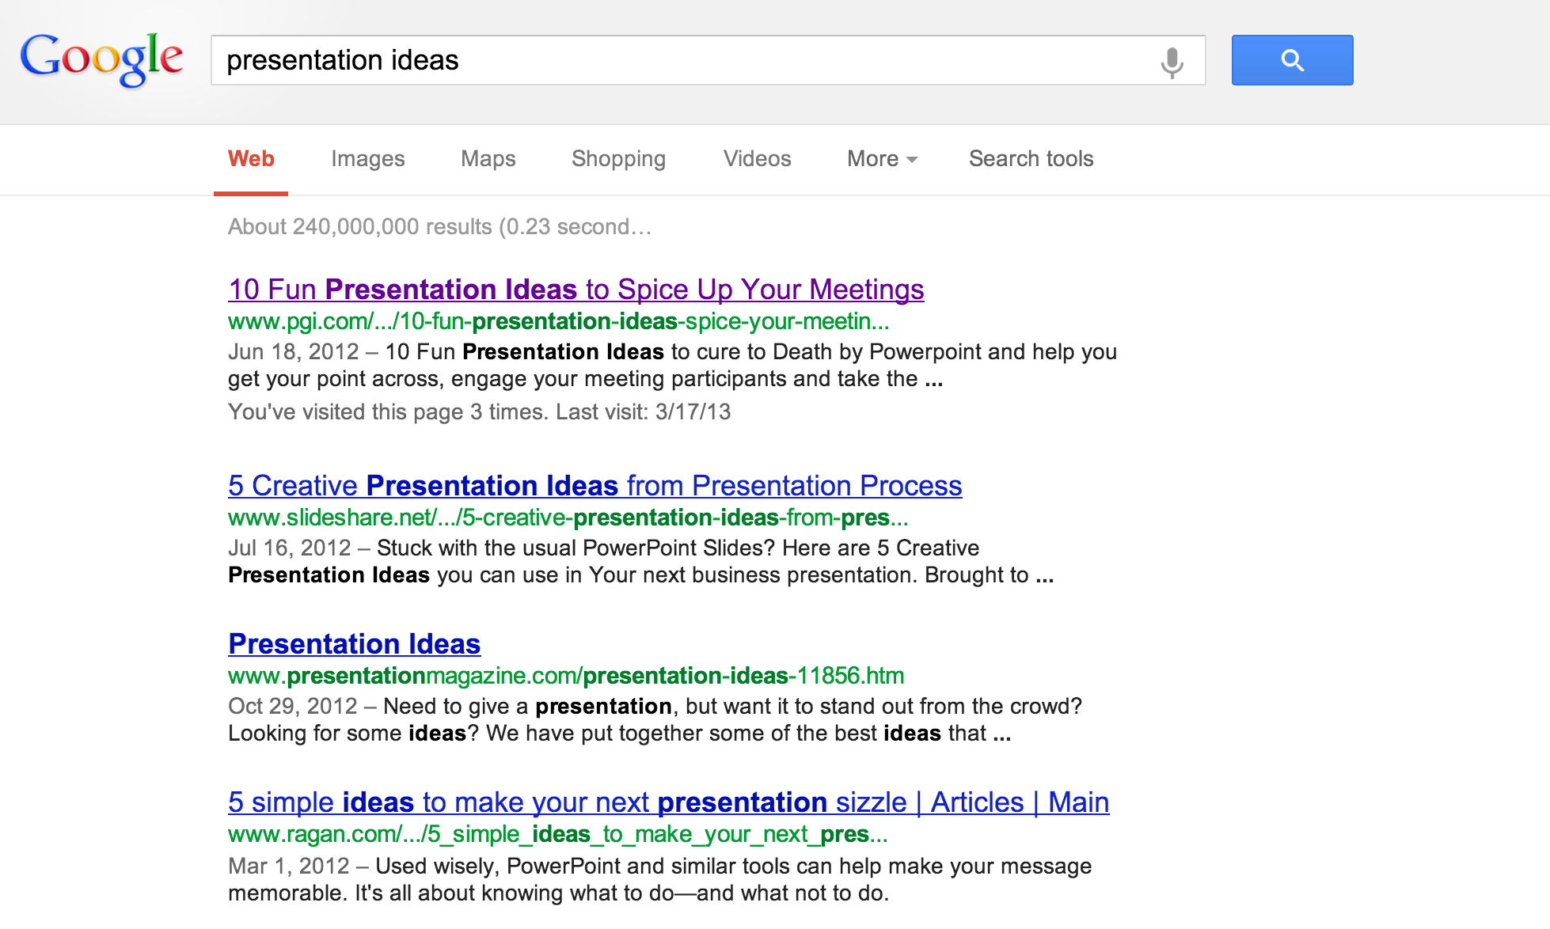
Content as a traffic driver

Slide 23
Top performing search terms
Pgi
Premiere global services
Presentation ideas
Global meet
Globalmeet
Pgi conferencing
Fun presentation ideas
Premier global services
Pgi global
Premiere global services inc

Slide 24
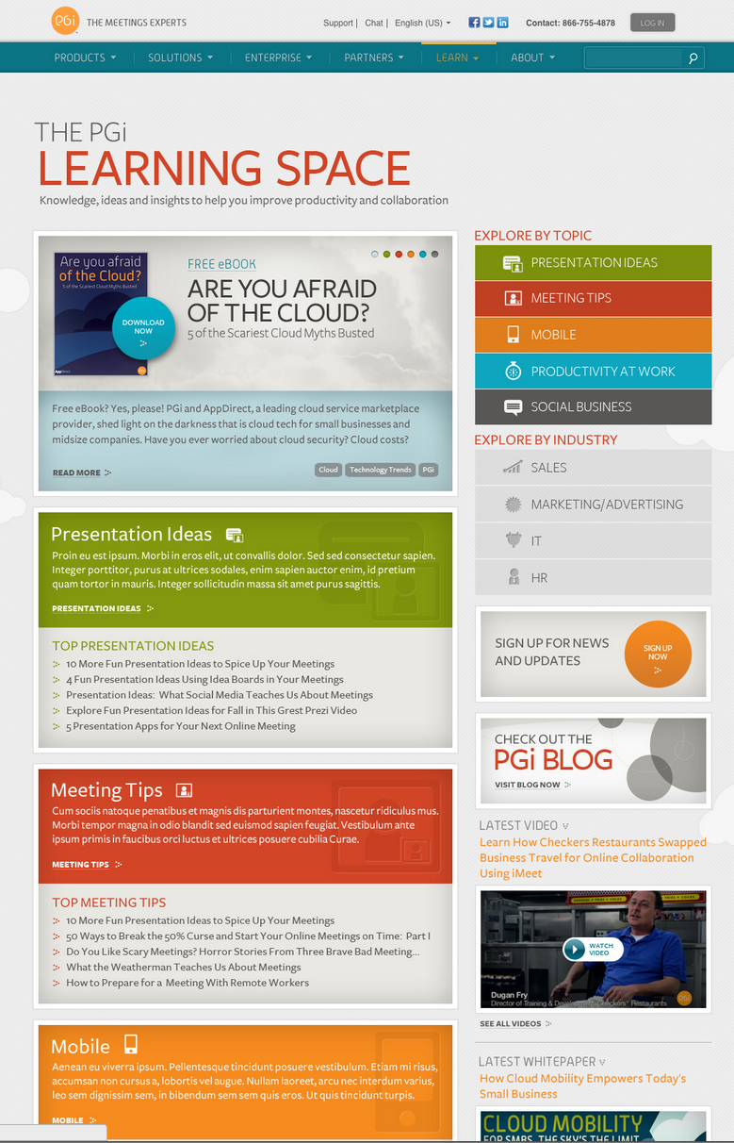

Slide 27
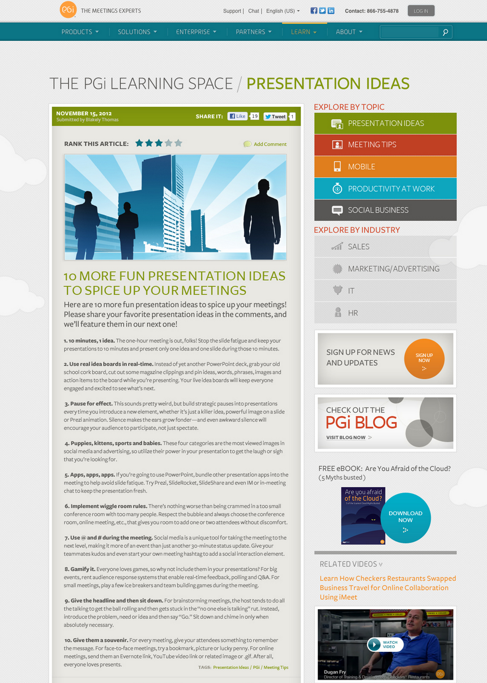

Slide 28
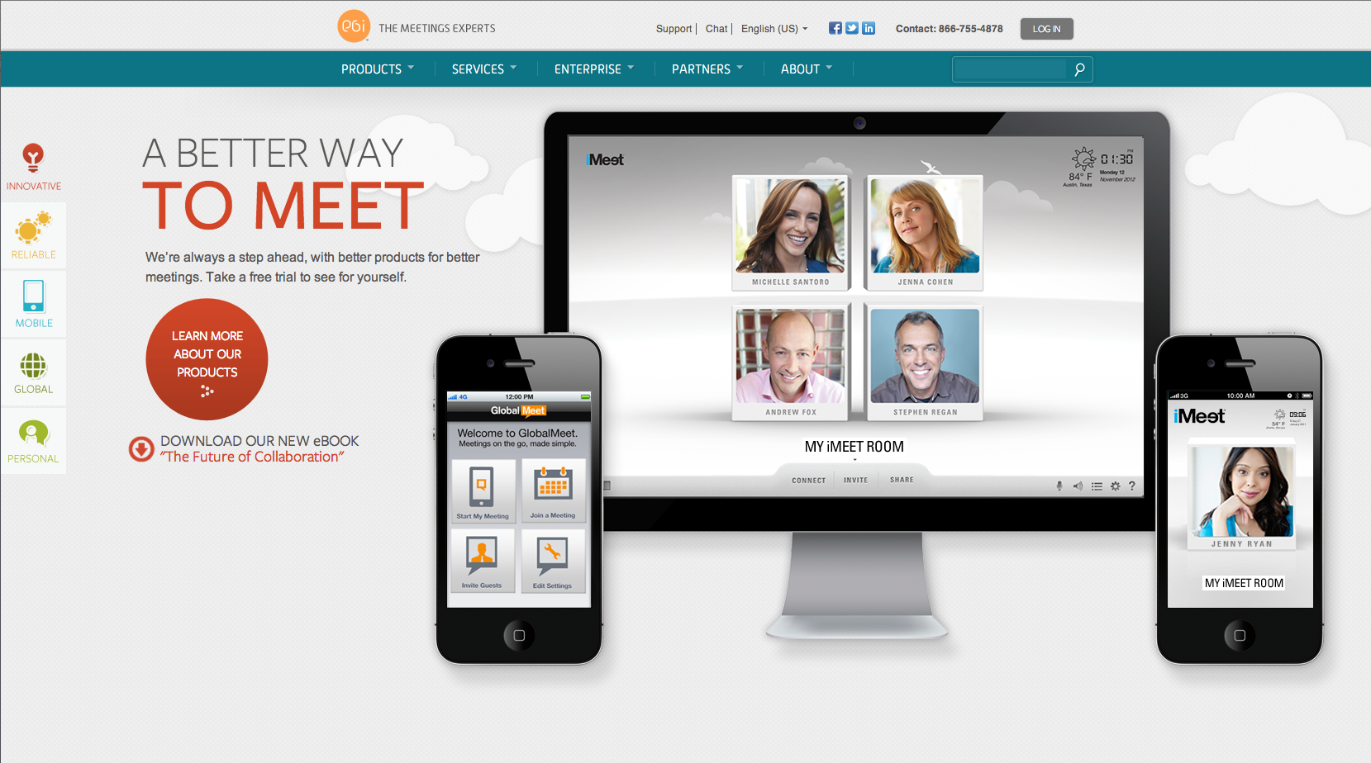
Prominence for premium content

Slide 29
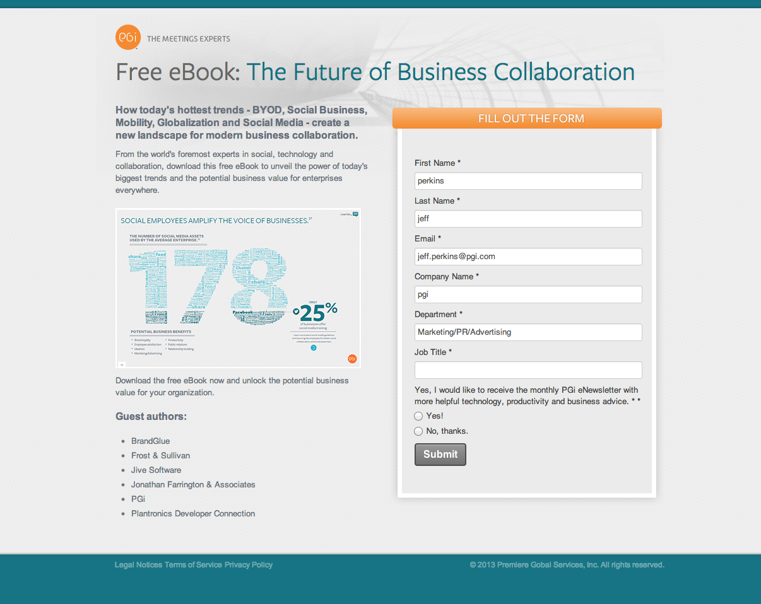
Premium content

Slide 30



Ebook results
10/22/12
1/21/13
3/8/13
243 Downloads
200 New Contacts
661 Downloads
381 New Contacts
37 Downloads
22 New Contacts

Slide 31
Current Customer
Objective: To help customers get the most value out of their investment
User guides
Tips and tricks
Product release notes
Best practices
FAQs
Objective: Provide added value that will keep the customer engaged
Insights and ideas
Proprietary research
Analysis and metrics
Specialized expertise
Product-Centric
Insight-Centric
Objective: Help prospects as they are making key buying decisions
Features and benefits
Pricing
Competitive comparison charts
Tech specs
Use cases
Customer Testimonials
ROI Calculators
Objective: Get on the radar of the prospects
Ideas and insights
Proprietary research
Analysis and metrics
Specialized expertise
Prospect

Slide 32
Lessons learned
Content is not a strategy
The funnel is not linear
Track and analyze
Use different content types – e-books, whitepapers, video, blogs, infographics
Leverage content for current customers and prospects
Make it interesting

Slide 33
Jeff Perkins
VP of Global Online Marketing
PGi
Email: jeff.perkins@pgi.com
LinkedIn: linkedin.com/in/jeffperkins1
Twitter: @jeffperkins8
Blog: SingleMindedProposition.com

